Slide 1

Supercharge your application witht the Microsoft Graph
Tiago Costa | @tiagocostapt
SharePoint Saturday Zurich 26.5.2018
@Kraftwert Impact Hub Zurich

Slide 2

Thanks to our Sponsors <3

Slide 3



Tiago Costa
Independent Contractor
MVP – Office Server and Services
MCT – Microsoft Certified Trainer and MCT RL – Regional Lead
IT Consultant, Trainer, Author and Speaker
MCT since 2006
tiago.costa@outlook.com | www.tiagocosta.eu
Follow me @tiagocostapt

Slide 4
“If having a coffee in the morning doesn’t wake you up, try to delete a table in production instead”
unknome developer

Slide 5
Agenda
Introduction to the Microsoft Graph
Getting started
SDKs and Code Samples
Resources

Slide 6
Slides and Demo
https://github.com/tiagocostapt/Presentations

Slide 7
Introduction to the Microsoft Graph

Slide 8
Developer Vision
Focus on User experience and their data.
We should bring user data and user experience into our applications.
Microsoft Office has over 1.2 billion users worldwide.
Office 365 numbers are huge with over 120 million monthly active subscribers.

Slide 9

Office 365 Developer momentum
"The most strategic developer surface area for us is Office 365“ - Satya Nadella

Slide 10

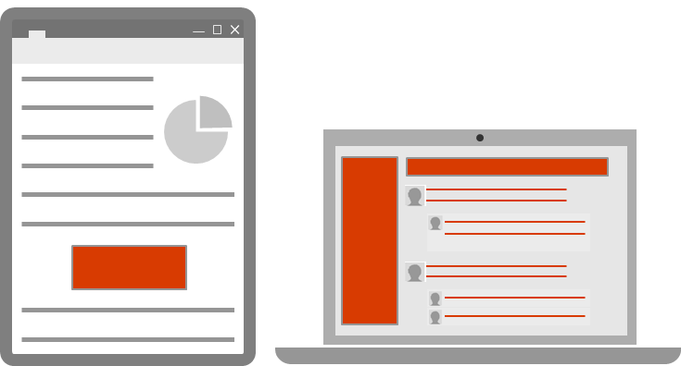
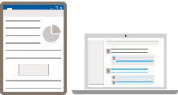
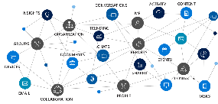
Office 365 Platform
Extensions
STANDALONE WEB AND DEVICE APPS
Documents
PAGES


Conversations
Embedded canvases
Canvases
Microsoft Graph

Slide 11
Microsoft Graph
Unified REST API
Comprehensive developer experience
Integrating data and Intelligence
Exposing Microsoft Services

Slide 12




Microsoft Graph
SECURITY ALERTS
DEVICES
THREAT INTELLIGENCE
INSIGHTS
ME
PARTNER
ROLES
ORGANIZATION
CONTENT
ORGANIZATION
ADMIN UNITS
REPORTS
GROUPS
USERS
APPS
USERS
CONTACTS
EMAIL
PEOPLE
TEAMS
SITES
DOCUMENTS

Slide 13
Microsoft Graph
Web apps
Native apps
Bots
Background Processes
Microsoft Graph

Slide 14
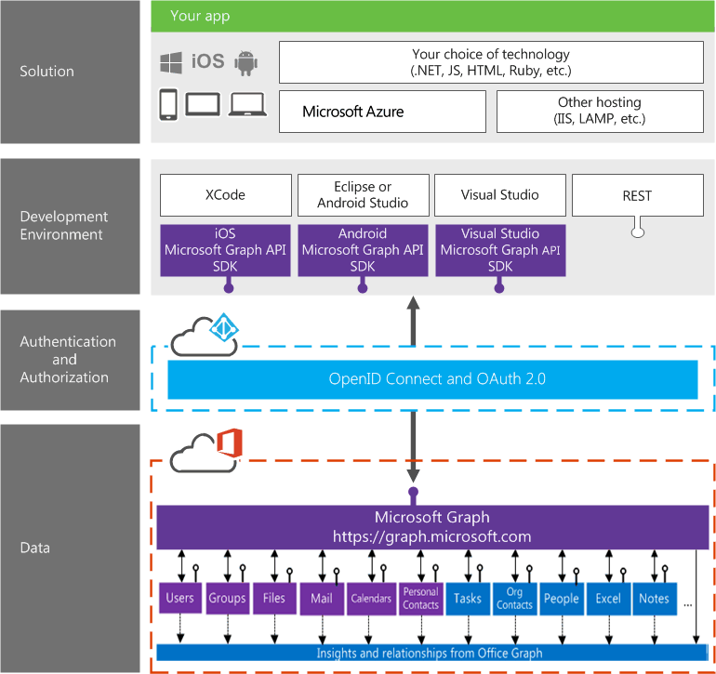
Office 365 Integration

Slide 15
Office 365 Integration

Slide 16
Microsoft Graph – Before
Different APIs for each of the Microsoft Office 365 Services: Files, Mail, Contacts, …
For each endpoint we had a different OAuth token

Slide 17
Microsoft Graph - Now
Gateway to Office 365
Single endpoint that proxies multiple Microsoft Services
Version endpoints – beta, v1.0
Simplifies token acquisition and management
Eliminates the need to traditional discovery

Slide 18
Single authentication flow
Sign users in using OAuth 2 / OpenID Connect
Apps Types:
Device apps
Web apps
SPAs
Background services
Web APIs
Pin apps to Microsoft Office 365 launcher (My apps)

Slide 19
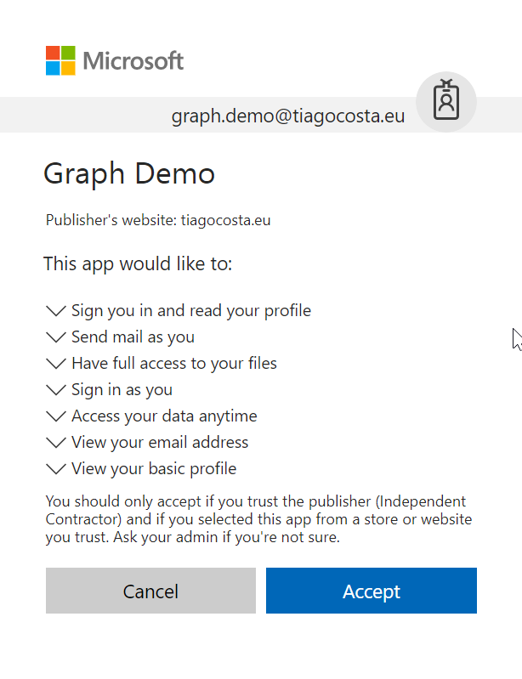
Common consent window
Single auth flow for accessing “all” O365 services
Admin and end-user consent
Secure protocol
OpenID Connect and OAuth 2.0
No capturing user credentials
Fine-grained access scopes
Long-term access through refresh tokens.

Slide 20
Authentication Option
Azure AD only – Azure AD v1.0
Separate auth flow supports Azure AD accounts only
Azure AD and Microsoft Accounts (Consumer) – Azure AD v2.0
Converged auth flow supports Azure AD accounts and Microsoft accounts (outlook.com, hotmail.com, etc.)
Many apps want to sign users in from both Microsoft account and Azure AD

Slide 21
Getting Started

Slide 22
Microsoft Graph API
Access user, group and organizational data
One endpoint
One token
All users
Your app
https://graph.microsoft.com
Users
Groups
SharePoint
Outlook
OneNote
Planner
Teams
Excel
Intune
Azure AD
more…

Slide 23
Calling the API
HTTP verbs dictate the request intent: GET | POST | PATCH | PUT | DELETE
Version: /v1.0 or /beta
Resource: /users, /groups, /sites, /drives, /devices, more…
Member from collection: /users/dan
Property: /users/dan/department
Traverse to related resources via navigations: /users/dan/events
Query parameters: /users/dan/events?$top=5
Format results: $select | $orderby
Control results: $filter | $expand
Paging: $top | $skip | $skiptoken
https://graph.microsoft.com
/{version}
/{resource}
/{id}
/{property}
?{query-parameters}

Slide 24
App types and permissions types
App type
Permission type
Who can consent
Effective Permissions
Get access on behalf of users
Get access as a service
Mobile | Web | SPA
Service and Daemon
Delegated permission (user permission)
Application permission
Users can consent
for their data
Admin can consent
for them or for all users
Only admin can consent
App permissions
User permissions
App permissions

Slide 25
Microsoft Graph
Demonstration
Microsoft Graph Explorer

Slide 26

Microsoft Graph Data
Active Directory
Users
profile
photo
direct reports
Groups
members
conversations
SharePoint
Sites
Lists
OneDrive
Files
upload
download
copy
versions
Outlook
Mail
messages
folders
send message
Calendar
events
find times
Excel
OneNote
Planner
Contacts
Directory
Beta
Teams
Insights
Project Rome
Devices
Activities
Intune
Reports
…and much more

Slide 27


GET: /users/dan
{
"displayName": "Dan",
"jobTitle": "PRINCIPAL PM MANAGER"
}
GET: /users/dan/photo/$value
Stream image/jpeg
GET: /users/dan/manager
{"displayName": “Agnieszka", …}
GET: /users/dan/directReports
"value" : [
{"displayName": "Jeff", …},
{"displayName": "Suresh", …},
]
GET: /me/memberOf
"value" : [
{"displayName": "Brits at Microsoft", …},
{"displayName": "Graph PM team", …}
]
With Microsoft Graph
Get the user profile
Agnieszka
manager
Groups
memberOf
Dan
directReports
Jeff
Suresh

Slide 28

GET /me/insights/trending
"value" : [
{"name": "presentation.pptx", …},
{"name": "forecast.xlsx", …}
]
GET /me/drive/recent
"value" : [
{"name": "guidelines.pptx", …},
{"name": "budget.xlsx", …}
]
GET /me/people/?$search="topic: planning"
"value" : [
{"displayName": “Yina", …},
{"displayName": “Dmitry", …},
]
POST /me/findMeetingTimes
{
"attendees": [
{
"type": "required",
"emailAddress": {
"address": "ana@contoso.com"
}
],
"meetingDuration": "2h"
}
With Microsoft Graph
Get insights based on activities
Out of office
Trending Documents
Find me the best time to meet Ana
Search people based on topics
People I’m working with
Recent Documents

Slide 29

Microsoft Graph Capabilities
Auth
Credentials
Work/School
Personal
OAuth scopes
Delegated (User)
App
OData
Filter
Order
Pagination
Compliance
Conditional access
National clouds
Query patterns
Web hooks
Delta
Extensions
Batching
SDKs & tools

Slide 30
Open Extensions
GET /me/message/<id>/?$expand=extensions
{
"displayName": “Dan",
"extensions": [
{
"extensionName": "Com.Contoso.Referral",
"companyName": "Wingtip Toys",
"expirationDate": "2017-12-30T11",
"dealValue": 10,000
}
]
}
Schema extensions
POST /schemaExtensions
{
"id": "graph_courses",
"targetTypes": [ "Group" ],
"properties": [
{
"name": "name",
"type": "String"
}…
]
}
GET /groups?$filter=courses/name eq Math101
Extending Microsoft Graph
Add extensions to user, group, mail & more
Customer referral email
Group: Math 101
PMP Certified
Favorite color: blue

Slide 31

GET/me/mailFolders/{id}/messages/delta
"@odata.deltalink":"me/mailfolders('AA')/messages/delta?$deltatoken=BB",
"value" : […]
POST /subscriptions
{
"changeType": "created,updated",
"notificationUrl": "https://app.net/callback",
"resource": "/me/mailfolders('AA')/messages",
}
GET/me/mailFolders/{id}/messages/delta ?$deltatoken=BB"
"value" : […]
With Microsoft Graph
Get notifications & track changes
Edited a file
Scheduled a new meeting
Got a new hire
Added a new member to a group
Got high important email

Slide 32
POST /$batch
{
"requests": [{
"id": "1",
"url": "/me/drive/root/children",
"method": "POST",
"body": {
"name": "folder1",
"folder": {}
},
"headers": {
"content-type": "application/json"
}
}, {
"id": "2",
"url": "/me/drive/root/children/folder1",
"method": "GET",
"dependsOn": ["1"]
}, {
"id": "3",
"method": "GET",
"url": "/me/planner/tasks"
}, {
"id": "4",
"method": "GET",
"url": "/groups/{id}/events"
}
]
}
With Microsoft Graph
Use $batch to combine multiple requests in one call
Documents
Calendar
Sites
Tasks
Email
Meetings
Contacts

Slide 33












SDKs, samples and tooling
GA*
GA
GA
GA
PREVIEW
ASP.NET MVC
JavaScript
Angular
PHP
Python
GA*
GA*
GA*
PREVIEW
PREVIEW
Xamarin
UWP
Android
iOS
Ruby
UPDATED
PREVIEW
VS integration
Bindings

Slide 34
Microsoft Graph SDK
Current version is 1.9.0 - https://www.nuget.org/packages/Microsoft.Graph
Always lagging behind the Graph REST API
Release Notes
May 2018 Release Summary (version 1.9.0)
New features (part list)
UserActivity - apps can push information to the user's timeline.
Updated timezone information.
Updates to Intune functionality.
New OneNote functionality which includes a notebook's site collection.

Slide 35
Microsoft Graph SDK - Install
To install Microsoft.Graph, run the following command in the Package Manager Console:
Install-Package Microsoft.Graph

Slide 36
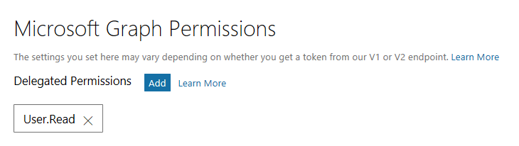
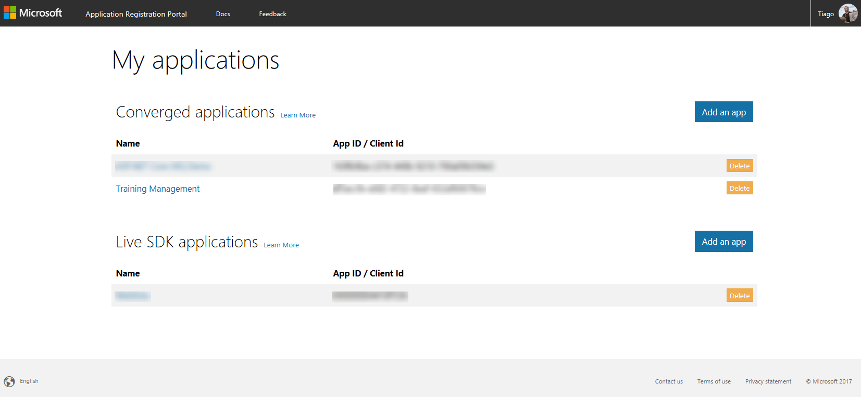
Application Registration Portal
Portal to register your apps
https://apps.dev.microsoft.com

Slide 37
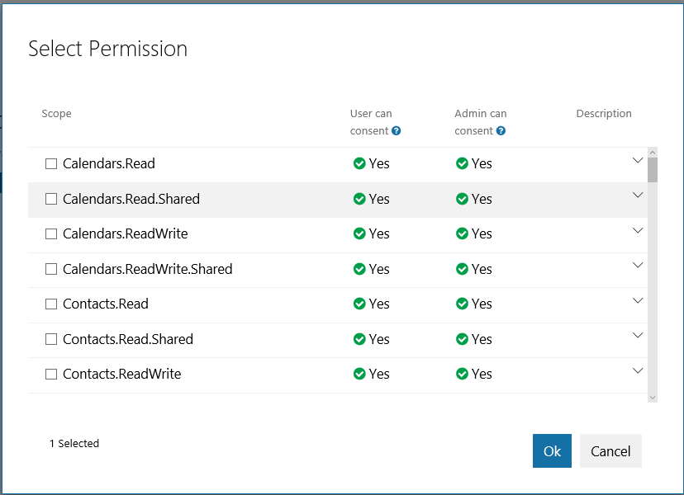
Microsoft Graph Permissions
When registering an app we need to select the needed permission that our app we have via Microsoft Graph.

Slide 38
Microsoft Graph
Demonstration
Register a new Application and using the Microsoft Graph SDK

Slide 39
Resources

Slide 40
Resources
Documentation, samples and more
https://graph.microsoft.com
https://github.com/microsoftgraph
Stack Overflow
[MicrosoftGraph]
Twitter
#MicrosoftGraph

Slide 41
Getting Started
Getting Started with APIs
https://developer.microsoft.com/en-us/graph/quick-start
Microsoft Graph API Code Samples
https://dev.office.com/code-samples
Microsoft Graph API documentation
https://developer.microsoft.com/en-us/graph/docs

Slide 42
Developer Program
1 YEAR FREE
E-mail Newsletters
Free Developer Subscription
Free Training
Free Tools
Webinars

Slide 43
My name is Tiago Costa
And this is how you build Intelligent Application with the Microsoft Graph.
tiago.costa@outlook.com
www.tiagocosta.eu

Slide 44
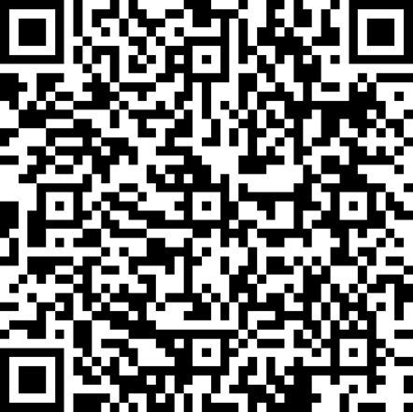
Evaluation Form
http://mvp.ms/SPSZurich2018
This survey is anonymous, but you can voluntarily enter your name and email address for a chance to win a license of Nintex Workflow Cloud.
Consent is necessary to participate to the lottery.

Slide 45
Thank you for attending!

